Slide 1


Signals & Systems for Computer Engineering
Prof.Dr. B.Berk ÜSTÜNDAĞ
Istanbul Technical University
Faculty of Computer Engineering and Informatics
BLG354E / CRN: 21615
6th Week Lecture (cont.)
2020
bustundag@itu.edu.tr
BLG354E / CRN: 21560
1st Week Lecture

Slide 2
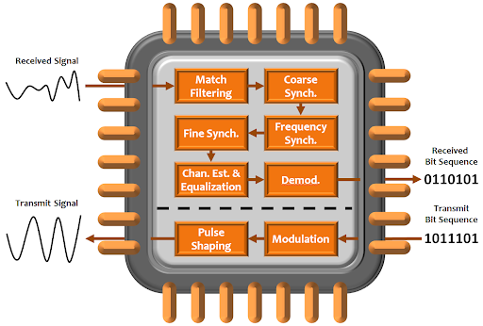
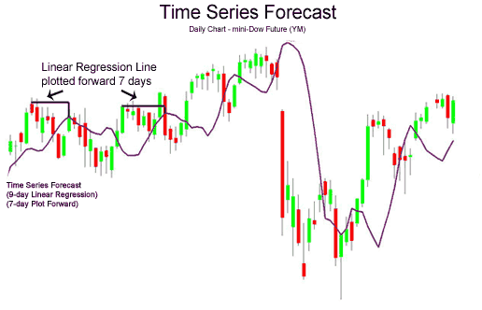
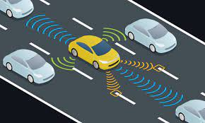
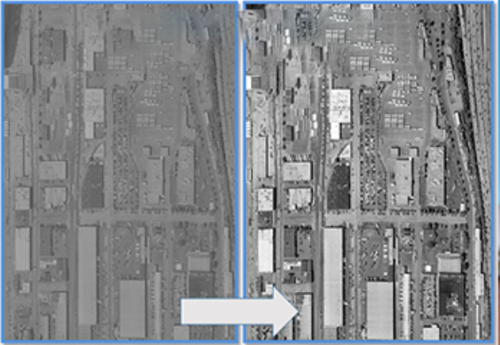
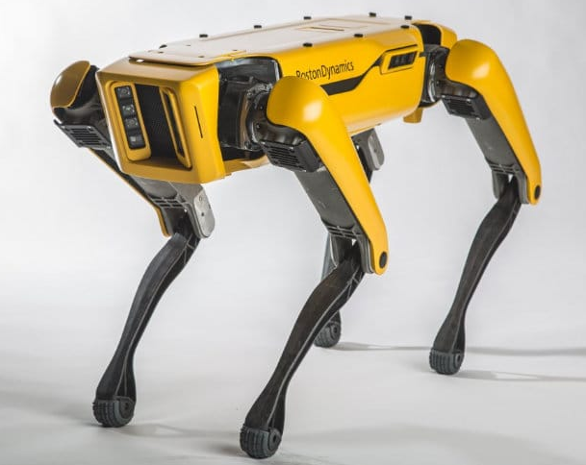
Introduction:
signal processing for communications
Neuro science and machine learning
Financial analysis and predictions
Autonomous Navigation
Image processing
Sensor fusion and control systems
BLG354E - İTÜ Faculty of Computer Engineering and Informatics - Üstündağ

Slide 3
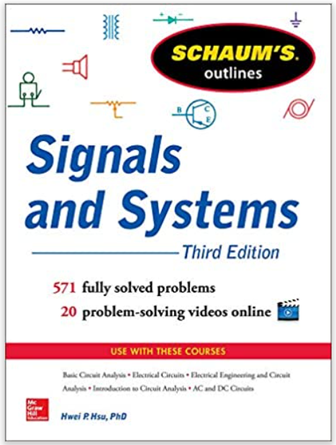
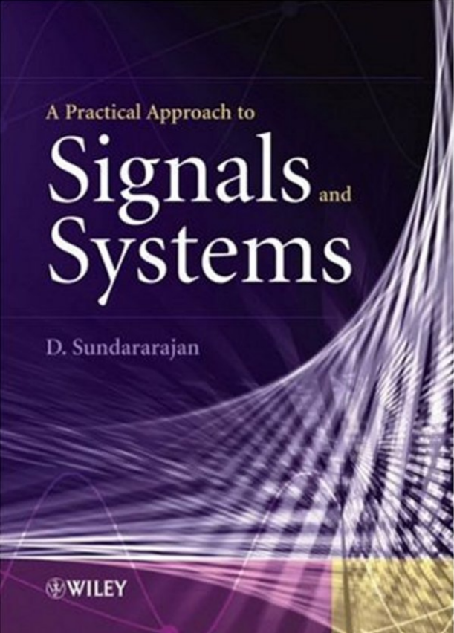

Text Books of the Course:
Main Text Book
Additional Application Examples
Programming Examples with Python
Hwei Hsu, 2013, McGraw-Hill
D. Sundararajan, 2008, JOHN WILEY
Allen B. Downey, 2016, O’REILLY
https://github.com/AllenDowney/ThinkDSP
BLG354E - İTÜ Faculty of Computer Engineering and Informatics - Üstündağ

Slide 4
Course Plan (2020-2021 Spring):
1st week: Introduction, Course Outline, Signals and Classification of the Signals
2nd week: Properties of Continuous Time Signals and Discrete Time Signals, Classification of the Systems
3rd week: Convolution Integral, Introduction to Linear Time Invariant (LTI) Systems
4th week: Properties and application examples of CT LTI Systems
5th week: Properties and application examples of DT LTI systems, FIR Filters
6th week: Real Time Programming and Simulation of DT Systems
7th week: Signal Processing Domains, Transforms and Laplace Transform of LTI Systems
8th week: Frequency Response of the Systems
9th week: Fourier Transform and its Applications, Spectral Analysis with Fourier Transform, Modulation
10th week: Convolution in frequency domain, Z Transform of DT Systems and convolution
11th week: Fourier Analysis of Discrete-Time Signals and Systems
12th week: Fast Fourier Transform
13th week: Digital Filter Design and Software Implementation
14th week: Generalized System design, analysis and programming applications
BLG354E - İTÜ Faculty of Computer Engineering and Informatics - Üstündağ

Slide 5
Grading Policy:
Quiz – 5 Weeks * | 10%
Homework Assignments (3) | 20%
Midterm | 30%
Final exam | 40%
* 4 best quiz scores out of 5 quizzes will be considered in average and the grading.
VF Condition:
At least 70% Attendance, Minimum of 4 out of 5 quizzes should be attended.
Overall visa score must be at least 30 (0.1xQuiz+0.2xHomework+0.3xMidterm≥18)
TAs: İlknur Çelik celikil17@itu.edu.tr
Asel Menekşe menekse16@itu.edu.tr
BLG354E - İTÜ Faculty of Computer Engineering and Informatics - Üstündağ

Slide 6
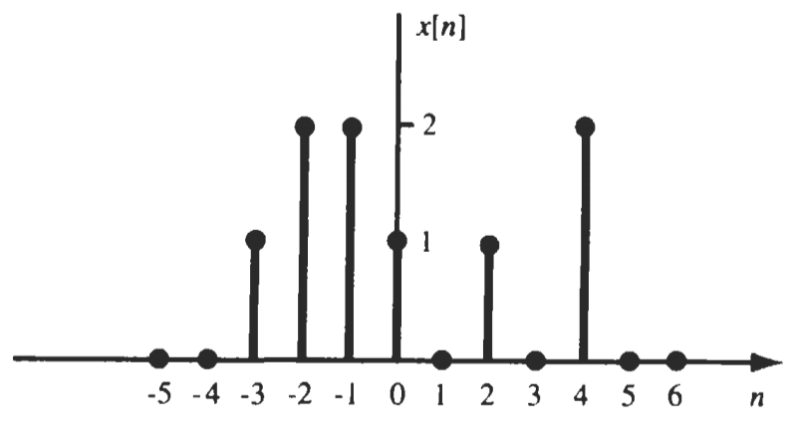
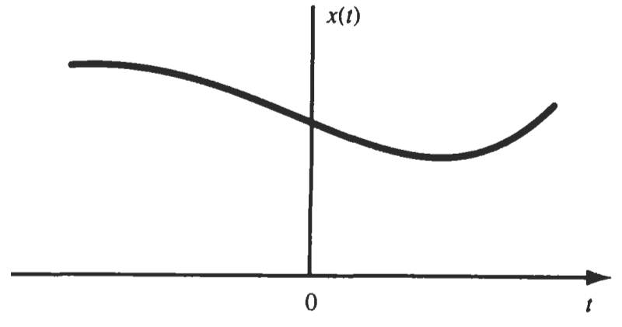
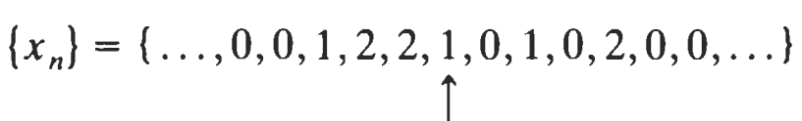
Continuous Time Signal
Discrete Time Signal
Sampling
of CT signal
T_{s}
T_{s}
T_{s}
T_{s}
T_{s}
T_{s}
A signal x(t) is a continuous-time signal if t is a continuous variable.
If t is a discrete variable, that is, x(t) is defined at discrete times, then x(t) is a discrete-time signal.
Time interval between sampling instants T_{s} is called the sampling period. When the sampling intervals are equal (uniform sampling) then:
x_{n}=x[n] =x(t=nT_{s})
BLG354E - İTÜ Faculty of Computer Engineering and Informatics - Üstündağ

Slide 7
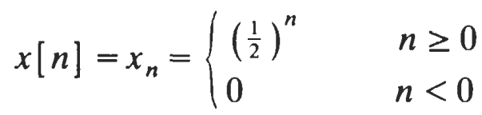

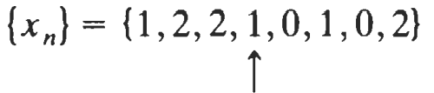
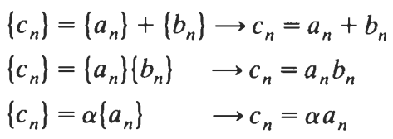

Notations for discrete time signal sequences:
a) Analytic expression:
b) Sequential expression:
n=0, x₀=1
Sum and product of two sequences:
where
BLG354E - İTÜ Faculty of Computer Engineering and Informatics - Üstündağ

Slide 8
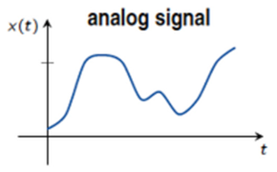
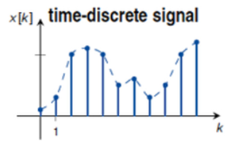
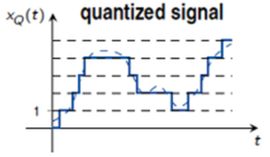
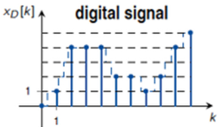
Analog and Digital Signals:
If a continuous-time signal x(t) can take on any value in the continuous interval (a, b), where a may be -∞ and b may be + ∞, then the continuous-time signal x(t) is called an analog signal.
sampling
quantization
quantization
sampling
If a discrete-time signal x[n] can take on only a finite number of distinct values, then we call this signal a digital signal.
BLG354E - İTÜ Faculty of Computer Engineering and Informatics - Üstündağ

Slide 9

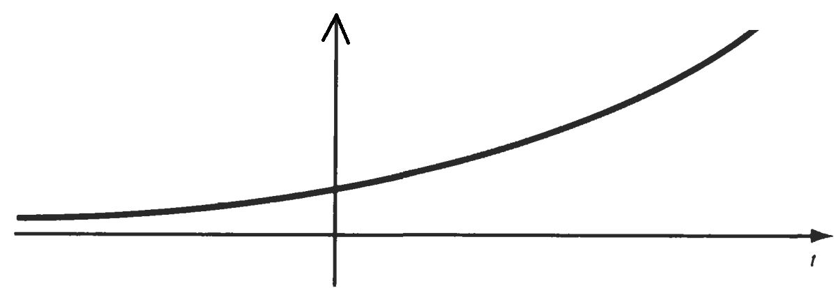
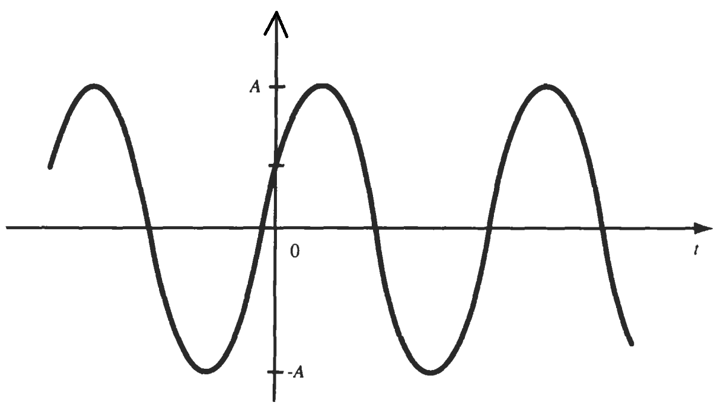
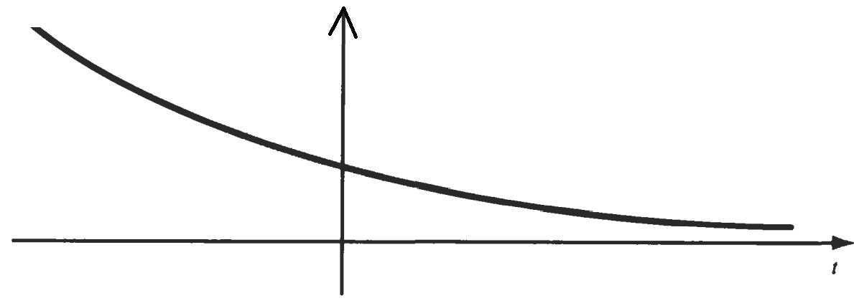

Real and Complex Signals:
A signal x(t) is a real signal if its value is a real number.
A signal x(t) is a complex signal if its value is a complex number such as x(t)=x₁(t)+jx₂(t) where j=$\sqrt{−1}$
s=σ+jω
def
Real
part
Imaginary
part
If x(t)=A·e^{j(ω t+ϴ)} then
x(t)= A$·$Re{e^{j(ω t+ϴ)}}+A$·$Im{e^{j(ω t+ϴ)}}
x(t)= A·cos(ωt+ϴ)+J·A·sin(ωt+ϴ)
x₁(t) + jx₂(t)
x(t)=e^{σt}
x₁(t)=Re{Ae^{j(ω t+ϴ)}}
=A·cos(ωt+ϴ)
ω=0 , σ>0 →
ϴ/ω
T=2π/ω
x(t)=e^{σt}
ω=0 , σ<0 →
Discrete time exponential signal:
BLG354E - İTÜ Faculty of Computer Engineering and Informatics - Üstündağ

Slide 10
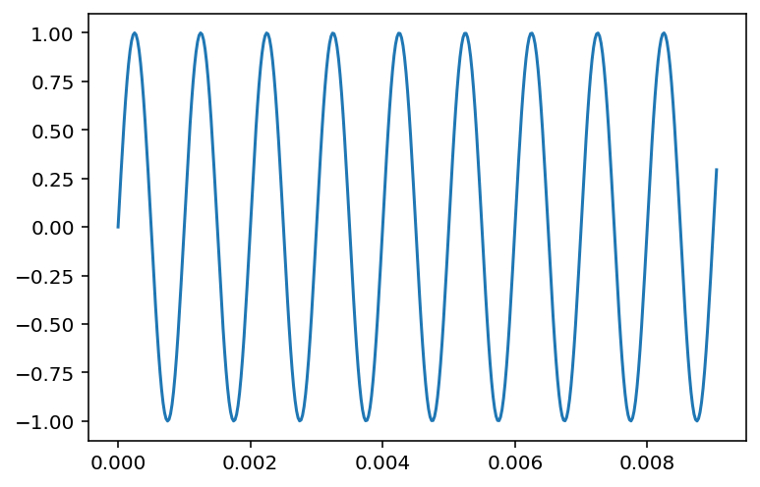
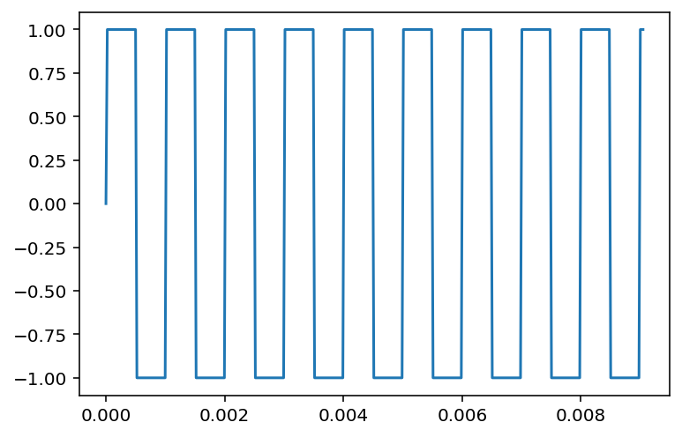
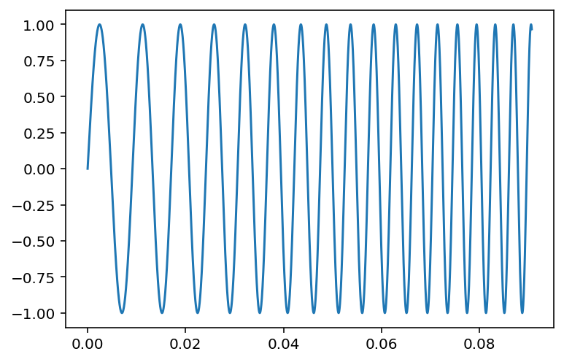
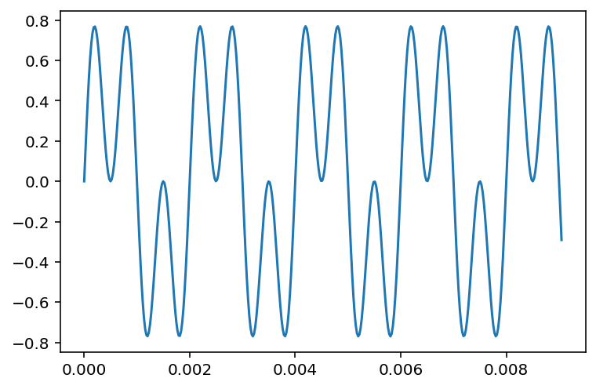
Waveform generation, draw and play in Python
# Sinusoidal and Square waveform sound generator
import numpy as np
import sounddevice as sd
import matplotlib.pyplot as plt
fs = 44100
time = np.arange(0, 4, 1/fs)
# 1- Fixed frequency sinusoidal sound at 1kHz
sound=np.sin(2*np.pi*1000*time)
# 2- square waveform:
#sound=np.sign(np.sin(2*np.pi*1000*time))
# 3- variable frequency sinusoidal waveform:
# sound=np.sin(2*np.pi*(100+1000*time)*time)
# 4- Multitone sinusoidal waveform:
#sound=0.5*(np.sin(2*np.pi*500*time)+np.sin(2*np.pi*1500*time))
plt.plot(time[0:400],sound[0:400])
sd.play(sound, fs)
ω=2πf
BLG354E - İTÜ Faculty of Computer Engineering and Informatics - Üstündağ

Slide 11
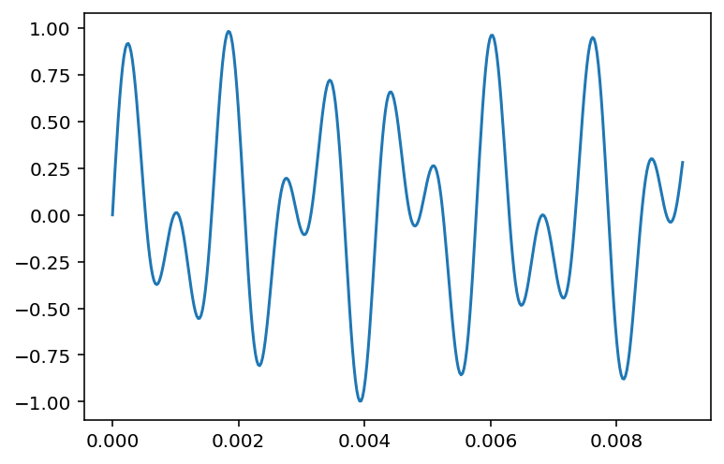
DTMF (Dual-Tone Multi-Frequency) :
# DTMF Tone Code Sequence
import numpy as np
import sounddevice as sd
import matplotlib.pyplot as plt
fs = 44100
time = np.arange(0, 1, 1/fs)
# DTMF waveform for the key sequence "1“ , "5", "9", "4"
sound1=0.5*(np.sin(2*np.pi*697*time)+np.sin(2*np.pi*1209*time))
sound2=0.5*(np.sin(2*np.pi*770*time)+np.sin(2*np.pi*1336*time))
sound3=0.5*(np.sin(2*np.pi*852*time)+np.sin(2*np.pi*1477*time))
sound4=0.5*(np.sin(2*np.pi*770*time)+np.sin(2*np.pi*1209*time))
sound=np.concatenate((sound1,sound2,sound3,sound4))
plt.plot(time[0:400],sound1[0:400])
sd.play(sound, fs)
Tone code for “1” → 697Hz + 1209Hz
(sound1)
BLG354E - İTÜ Faculty of Computer Engineering and Informatics - Üstündağ

Slide 12
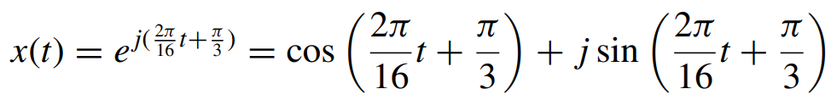
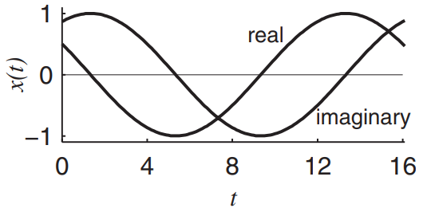

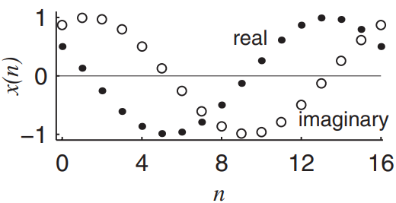
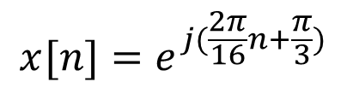
Example:
Illustrate the signal
as CT signal and for the case if it is discretized at f_{s}=1Hz
$$x[n]=e^{j(\frac{2π}{16}n+\frac{π}{3})}$$
BLG354E - İTÜ Faculty of Computer Engineering and Informatics - Üstündağ

Slide 13
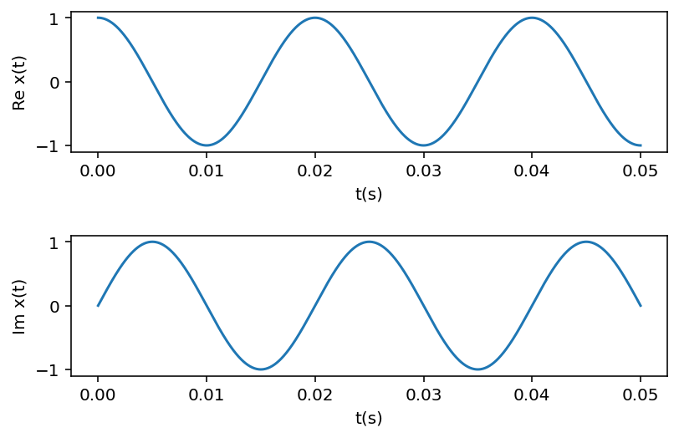
Plot of Complex CT Signal in Python
# Continuous time Complex signal @50Hz
import numpy as np
import matplotlib.pyplot as plt
Duration=0.05 # 50ms time window
Resolution=1000
f=50 # Frequency=50Hz
t = np.linspace(0, Duration, Resolution)
plt.subplot(2,1,1);
plt.plot(t, np.exp(2j*np.pi*f*t).real );
plt.xlabel('t(s)');
plt.ylabel('Re x(t)');
plt.subplot(2,1,2);
plt.plot(t, np.exp(2j*np.pi*f*t).imag);
plt.xlabel('t(s)');
plt.ylabel('Im x(t)');
plt.tight_layout(pad=2.0)
plt.show()
x(t)=e^{jωt}= e^{j2πft}
Real(x(t))
Imaginary(x(t))
BLG354E - İTÜ Faculty of Computer Engineering and Informatics - Üstündağ

Slide 14
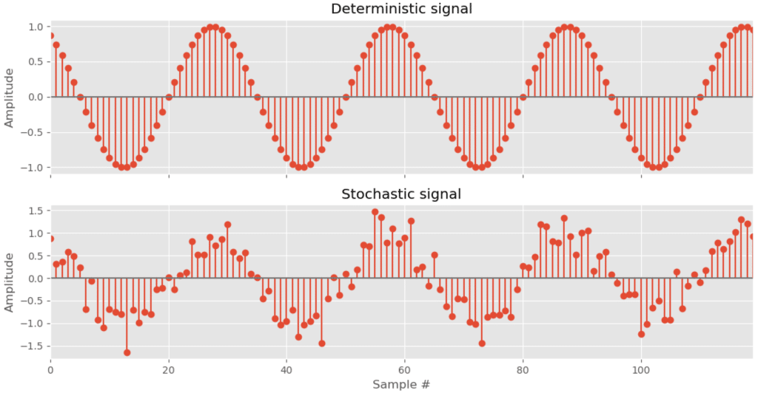
Deterministic and Stochastic Signals:
Deterministic signals are those signals whose values are completely specified for any given time. Thus, a deterministic signal can be modeled by a known function of time
Random/Stochastic signals are those signals that take random values at any given time and must be characterized statistically.
BLG354E - İTÜ Faculty of Computer Engineering and Informatics - Üstündağ

Slide 15
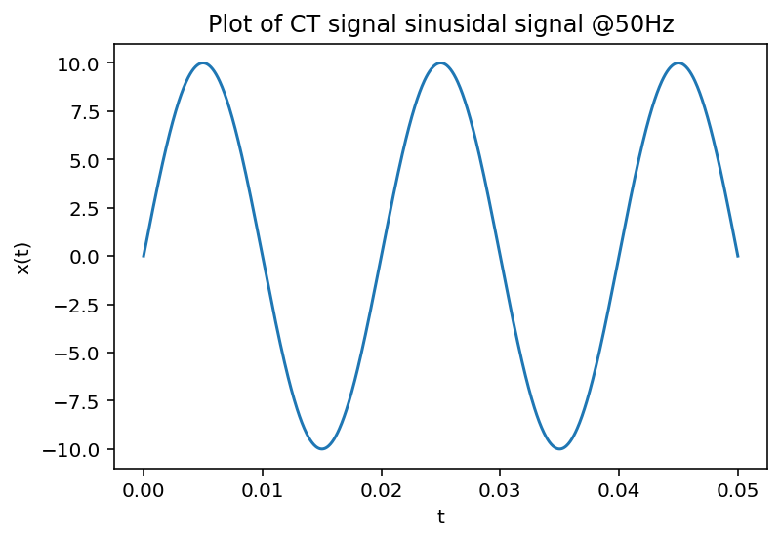
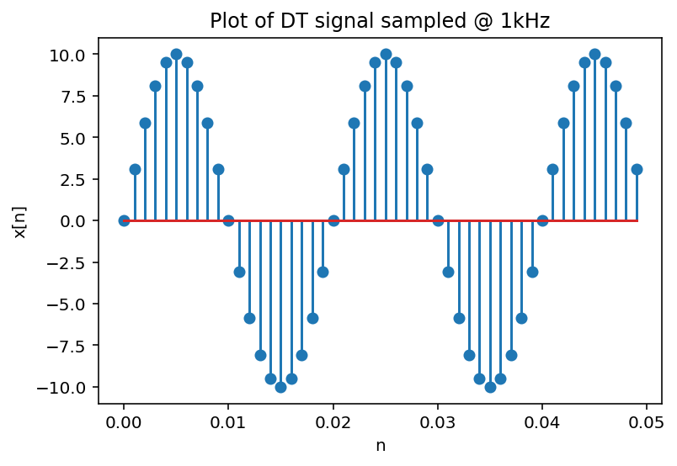
Plot of Discrete Time Signal in Python
#Continuous time sinusoidal signal @50Hz
# and its discrete form when it is sampled @1000kHz
import numpy as np
import matplotlib.pyplot as plt
Duration=0.05 # 50ms time window
Resolution=1000
t = np.linspace(0, Duration, Resolution)
plt.plot(t, 10 * np.sin(2*np.pi*50*t));
plt.xlabel('t');
plt.ylabel('x(t)');
plt.title('Plot of CT signal sinusidal signal @50Hz');
plt.show()
# Sample at 1ms and draw the DT signal:
Ts = 0.001 # Sampling period
n = np.arange(0,Duration,Ts);
x = 10*np.sin(2 * np.pi * 50 * n)
plt.xlabel('n');
plt.ylabel('x[n]');
plt.title('Plot of DT signal sampled @ 1kHz');
plt.stem(n, x);
BLG354E - İTÜ Faculty of Computer Engineering and Informatics - Üstündağ

Slide 16
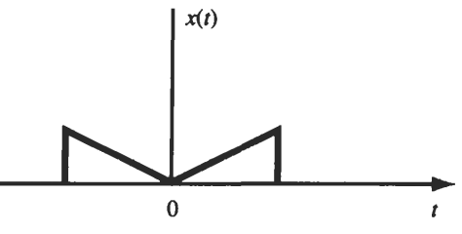
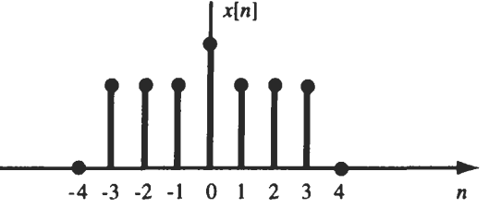
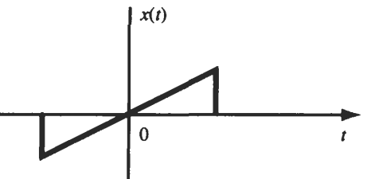
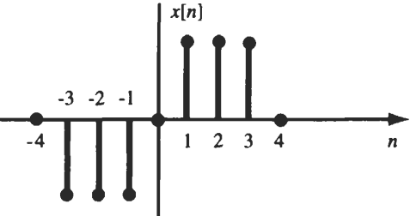
Even and Odd Signals:
A CT signal x(t) is referred to as an even signal if x(-t)=x(t)
A DT signal x[n] is referred to as an even signal if x[-n]=x[n]
A CT signal x(t) is referred to as an odd signal if x(-t)=-x(t)
A DT signal x[n] is referred to as an odd signal if x[-n]=-x[n]
BLG354E - İTÜ Faculty of Computer Engineering and Informatics - Üstündağ

Slide 17
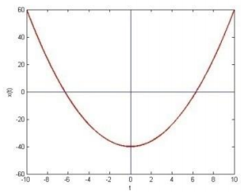

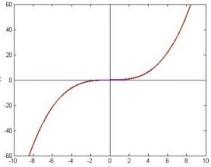

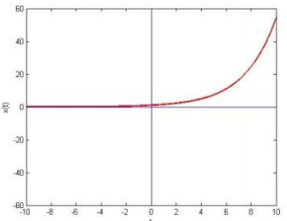
Example:
BLG354E - İTÜ Faculty of Computer Engineering and Informatics - Üstündağ

Slide 18
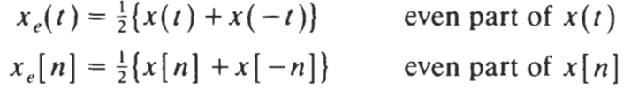


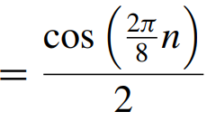

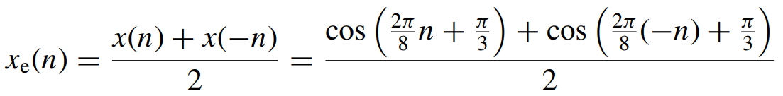
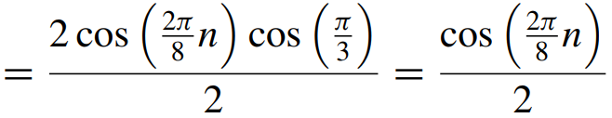
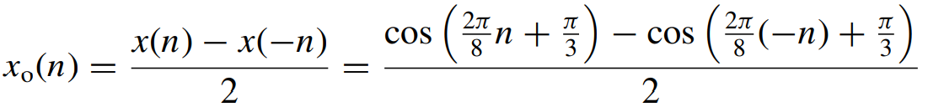
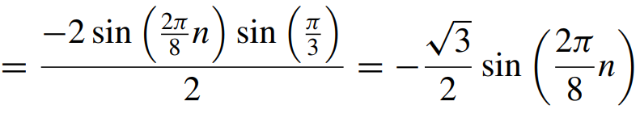
Decomposition Theorem:
Any signal x(t) or x[n] can be expressed as a sum of two signals, one of which is even and one of which is odd.
where
Example:
?
→
The even-symmetric component of x(n):
The odd-symmetric component of x(n):
BLG354E - İTÜ Faculty of Computer Engineering and Informatics - Üstündağ

Slide 19




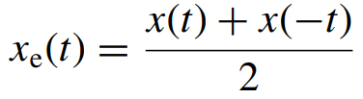
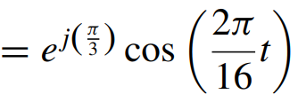
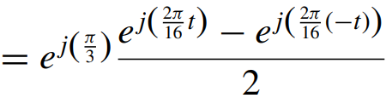
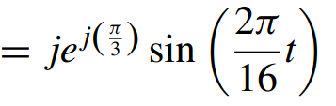




Integral of decomposed signals:
Integral of an odd-symmetric signal x_{o}(t) over symmetric limits is zero
This property will be used for a simplification of Fourier Series
Example:
in terms of its symmetric components
Express the signal
+
+
BLG354E - İTÜ Faculty of Computer Engineering and Informatics - Üstündağ

Slide 20








Periodic and Nonperiodic Signals:
A continuous-time signal x(t) is said to be periodic with period T if there is a positive nonzero value of T for which
x(t+T)=x(t) for all t
A discrete-time signal x[n] is said to be periodic with period N if there is a positive nonzero value of N for which
x[n+N]=x[n] for all n
Smallest value of T or N that satisfies the above
condition is called fundamental period
Signals do not satisfy periodicity conditions are called non-periodic signals
Example:
Determine the fundamental period of $x(t)=e^{j\frac{3πt}{5}}$
x(t+T)=x(t)
→
Determine the fundamental period of $x[n]=e^{j\frac{3πn}{5}}$
x[n+N]=x[n]
→
BLG354E - İTÜ Faculty of Computer Engineering and Informatics - Üstündağ

Slide 21












Proof:
Prove that
is periodic and find its fundamental period
If x(t) is periodic then
ω₀=0 → x(t)=1 and it is periodic for all T
→
ω₀≠0 →
$$T_{0}=\frac{2π}{ω_{0}}$$
and the fundamental period T₀ is the smallest positive T
→
If we consider the periodicity criteria for the DT case:
is periodic if
→
where m is a positive integer
→
x[n] is periodic only if
is a rational number
BLG354E - İTÜ Faculty of Computer Engineering and Informatics - Üstündağ

Slide 22









Example:
x(t) is a CT signal given as x(t)=cos(15t). Find the fundamental period of the DT signal x[n]
if x[n] is discretized by sampling x(t) at the sampling frequency $f_{s}=\frac{10}{π}$ Hz
x[n] = x(nT_{s})
T_{s}=1/f_{s}=0.1π seconds
x(t)=cos(ωt)=cos(15t)→ ω=15 rad/s
The fundamental period of x(t) :
$$T_{0}=\frac{2π}{ω_{0}}=\frac{2π}{15}$$
x[n] is periodic if
Since m and N₀ are positive integers →
→
If x[n] is periodic then
m=3 provides N₀ to be the smallest positive integer.
Fundamental period of x[n] is N₀=4
BLG354E - İTÜ Faculty of Computer Engineering and Informatics - Üstündağ

Slide 23



Example:
(Case study for the signal having multiple periodic components)
Find the fundamental frequency of the signal x[n]
Fundamental period of the first exponential is 3
Fundamental period of the second exponential is 8
Since the least common multiple of the periods of the two signals is 24,
x[n] is periodic with N₀=24
BLG354E - İTÜ Faculty of Computer Engineering and Informatics - Üstündağ

Slide 24







Example:
Find the fundamental frequency of
x(t)=x₁(t)+x₂(t)
Periods of x₁ and x₂:
is irrational
Therefore x(t) is not periodic and there is no fundamental frequency
BLG354E - İTÜ Faculty of Computer Engineering and Informatics - Üstündağ

Slide 25









Example:
Find the fundamental period of the DT signal x[n]
The least common multiple of the denominators is 12 →
Fundamental frequency is ω₀ = π/12
→
The fundamental period is T = 2π/ω₀ = 24 and the three terms are the 4th, 9th and 10th harmonic of ω₀
Example:
Find the fundamental frequency of the CT signal x(t)
x(t) = x₁(t) + x₂(t) + x₃(t)
The frequencies and periods of x₁(t), x₂(t) and the x₃(t) are:
The fundamental angular frequency is ω₀ = π/12
and the fundamental period is T₀ = 2π/ω = 24
f₀ = 1/24
→
BLG354E - İTÜ Faculty of Computer Engineering and Informatics - Üstündağ

Slide 26




Energy and Power Signals:
If v(t) is the voltage drop across the resistor R while the current is i(t) then the instantaneous power p(t) per ohm is defined as
Then the total energy E and average power P on a per-ohm basis are
If we make an analogy to 1 ohm basis Energy and Power definition, then normalized energy content E of an arbitrary continuous-time signal x(t) is defined as
and the normalized average power P of x(t) is
BLG354E - İTÜ Faculty of Computer Engineering and Informatics - Üstündağ

Slide 27








Similarly the normalized energy content E of a discrete-time signal x[n] can be expressed as
Then the normalized average power P of x[n] is given as
Energy signal: x(t) is said to be an energy signal or x[n] is said to be an energy sequence
if and only if 0<E<∞ , and so the power P=0.
Power signal: x(t) is said to be a power signal or x[n] is said to be a power sequence
if and only if 0<P<∞, and so the energy E = ∞
If a signal do not satisfy any of these properties then it is neither an energy signal nor a power signal.
Example:
x[n]=(-0.5)^{n}u[n]
Determine if x[n] is an energy or power sequence
Hence it is an energy signal since we got finite energy and zero power
BLG354E - İTÜ Faculty of Computer Engineering and Informatics - Üstündağ

